Slide 1

Kiet
kki
HACKATHON
TEAM - 6

Slide 2
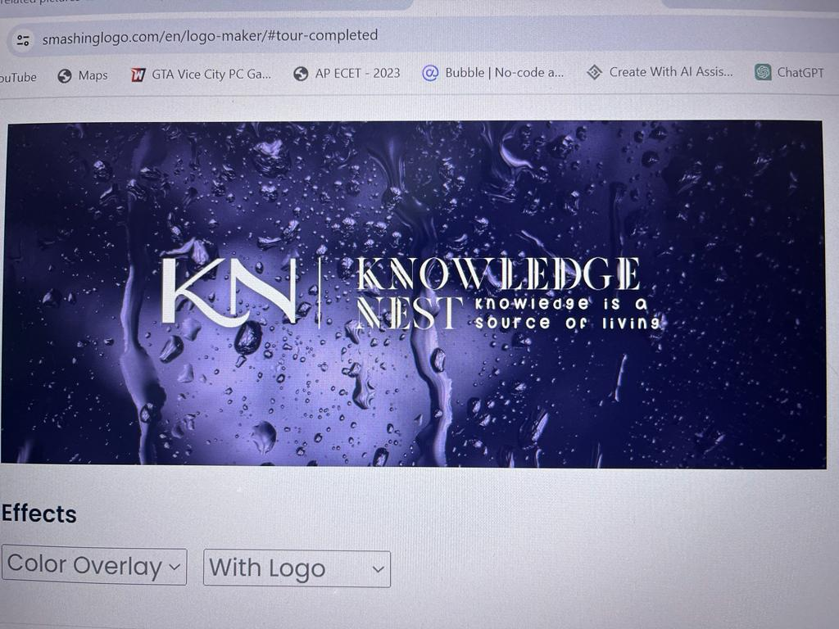

Slide 3
DIFFERENCE BETWEEN HTML AD CSS
HTML
CSS
HTML is a standard markup language for describing the structure of web pages
HTML is simple to understand and has a clear syntax
HTML cannot be used with any xml-based markup language
HTML codes can never be foundin CSS files
1) CSS is a style sheet language for describing the presentation design of online pages
CSS can be complicated at times and cause coding difficulties
CSS is not depends on HTML and may be used with any XML-based markup language
CSS codes can be found in HTML files

Slide 4

DURING THIS PROCESS OF CREATING A WEB PAGE WE USED HTML AND CSS TAGS
EXAMPLE
1)<head>
2)<body>
3)<title>

Slide 5

ONLINE LEARNING PLATFORM HOMEPAGE
HIGHLITING COURCES,INSTRUCTORS, AND KEY FEATURES

Slide 6

KNOWLEDGE NEST
WE ARE BUILDING THIS WEB PAGE IN THE NAME OF KNOWLEDGE NEST.
WE CREATING THIS PLATFORM FOR EMPOWRING THE NEXT LEVEL LEARNING.

Slide 7

TO CONECT WITH THE USER HOME PAGE IS A KEY
IF WE BUILD IT USER FRIENDLY MOST OF THE PEOPLE WHO USE THIS PLTFORM GET MORE INTEST TO USE
THIS IS THE MAJOR IMPORTANCE OF HOME PAGE

Slide 8
Online courses provide flexible, affordable learning with diverse subjects and global accessibility. They foster an inclusive community but require self-discipline for success.

Slide 10

WE ARE HILITING THE INSTAROCTORS
THIS IS MAJORLY USED TO
MORE ENROLLMENT OF STUDENTS
BECAUSE OF REPUTATION OF INSTAROCTORS

Slide 11

WE ARE PREPARING THIS PAGE IN RESPONCIVE DESIGN
THE NECSSITY OF RESPONSIVE DESINE IS IT CAN ADJUST ON ANY SCEEN SIZE
IT MEANS YOU ARE OPEN THE PAGE IN MOBILE IT CAN ADJUST TO MOBILE SCREEN SIZE …

